Slide 1
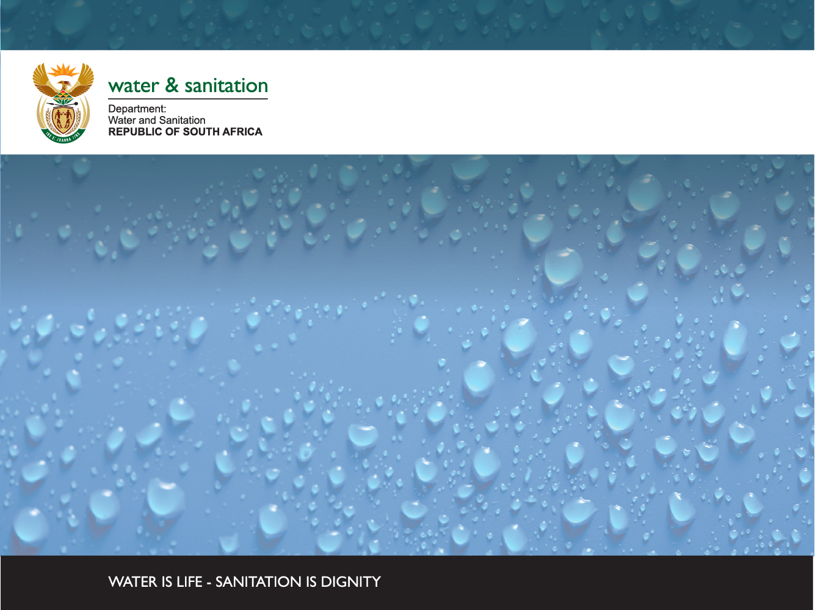
MVOTI TO UMZIMKULU NWRCS
WATER QUALITY:
CONSEQUENCES TO SCENARIOS (MKOMAZI & MVOTI)
Patsy Scherman
Scherman Colloty & Associates
26 November 2014
DWA CORPORATE IDENTITY
Presented by:
Johan Maree
Deputy Director: Media Production
12 December 2012

Slide 2
STEPS 4 + 6 of CLASSIFICATION: WATER QUALITY
Water quality = two broad components
  Ecological, i.e. as part of the EWR or Reserve process. Output = EcoSpecs.
  Non-ecological or Users, i.e. UserSpecs (excl. aquatic ecosystems + includes users such as irrigation, stock-watering, domestic, recreation and industrial).
  UserSpecs and consequences of scenarios (Step 4)
    Wq included in ECOLOGICAL CONSEQUENCES and ECOSYSTEM SERVICES
    Wq included indirectly in the ECONOMICS in terms of water treatment costs
    USER WQ: Evaluate Impact of scenarios on users by (1) identifying primary users, (2) identifying driving wq variables + (3) use of model (quantitative) or alternative qualitative approach to assess consequences

Slide 3
USER WATER QUALITY STEPS
Identify priority RUs and water quality hotspots
Step 1
Step 2
Identify priority users + link them to the identified RUs. Use Reserve info for aquatic ecosystems
Step 3
Identify driving variables
Step 4
Test all info with Technical Working Group
Determine consequences on driving variables
Identify range of scenarios + RUs impacted on
Step 5
Use with other consequences information, select optimal scenarios, select Water Resource Classes and associated catchment configuration
Rank scenarios
Step 6

Slide 4
TO SUMMARIZE, CONSEQUENCES ON WATER QUALITY PER SCENARIO AND PER RELEVANT RU AND IUA WAS SCORED USING THE DRIVING WATER QUALITY VARIABLES LINKED TO THE PRIMARY WATER QUALITY ROLE PLAYERS. NOTE THAT ALTHOUGH THE AQUATIC ECOSYSTEM IS THE RESOURCE BASE RATHER THAN A “USER”, IT WAS GROUPED AND EVALUATED WITH OTHER USERS FOR PURPOSES OF THIS STEP OF THE CLASSIFICATION PROCESS.

Slide 5
RESULTS – WATER QUALITY CONSEQUENCES
No scale is shown on the bars as the process undertaken was qualitative and in relation to Current State (CS)
CS relates to the water quality state
CS per river reach can therefore be assessed comparatively, that is, if CS is lower on one bar than the other, then water quality is assumed to be poorer at that site
The impact of scenarios (denoted as Sc x) have been considered in relation to CS
It is expected that if a scenario has little impact on ecological water quality, it is unlikely to have a large impact on the water quality linked to any user

Slide 6

MKOMAZI RIVER (1)
CS,
All Sc
Site location
MRU Mkomazi B, incl
MK_I_EWR1
CS,
All Sc
Site location
MRU Mkomazi C, incl MK_I_EWR2
Sc2
Sc2
Wq role players
Some agriculture,
erosion
Primary wq role players
Agriculture
Primary wq drivers
Nutrients, turbidity
Primary wq drivers
Nutrients, salts

Slide 7
MKOMAZI (2) AND MVOTI RIVERS
CS,
All Sc
Site location
MRU Mkomazi C, incl
MK_I_EWR3
Sc2
Site location
MRU Mvoti C, including MV_I_EWR2
Sc42,43
Primary users
Agriculture;
settlements
CS
Sc3
Primary wq drivers
Nutrients, salts,
E. coli / coliforms
Primary users
Low density rural settlements; over-grazing
Primary wq drivers
Turbidity

